Slide 1

Software Project Management
Dr. Sumaira Nazir
Department of Software Engineering
National University of Modern Languages, Islamabad

Slide 2
Project Schedule Management

Slide 3
Project Schedule Management
Involves the processes required to ensure timely completion of a project

Slide 4
Project Schedule Management-Processes

Slide 5
Project Schedule Management-Processes
Planning Schedule Management
Defining Activities
Sequencing Activities
Estimating Activity Duration
Developing the Schedule
Controlling the Schedule

Slide 6
Six main processes are involved in project schedule management
Planning schedule management
involves determining the policies, procedures, and documentation that will be used for planning, executing, and controlling the project schedule

Slide 7
Six main processes are involved in project schedule management
Defining activities
involves identifying the specific activities that the project team members and stakeholders must perform to produce the project

Slide 8
Six main processes are involved in project schedule management
Defining activities
An activity or task is an element of work normally found on the work breakdown structure (WBS) that has expected duration, cost, and resource requirements

Slide 9
Six main processes are involved in project schedule management
Sequencing activities
involves identifying and documenting the relationships between project activities.

Slide 10
Six main processes are involved in project schedule management
Estimating activity durations involves
estimating the time needed to complete individual activities

Slide 11
Six main processes are involved in project schedule management
Developing the schedule involves
analyzing activity sequences, resource requirements, and activity duration estimates to create the project schedule.
GANTT Chart

Slide 12
Six main processes are involved in project schedule management
Controlling the schedule involves
controlling and managing changes to the project schedule

Slide 13
Planning Schedule Management
The first step in project schedule management is planning how the schedule will be managed throughout the life of the project.
Project schedules grow out of the basic documents that initiate a project.
The project charter often mentions planned project start and end dates, which serve as the starting points for a more detailed schedule

Slide 14
Planning Schedule Management
In general, a schedule management plan includes the following information
Project schedule model development:
Many projects include a schedule model, which contains project activities with estimated durations, dependencies, and other planning information that can be used to produce a project schedule.
Level of accuracy and units of measure:
how accurate schedule estimates should be and determines whether time is measured in hours, days, or another unit.

Slide 15
Planning Schedule Management
Control thresholds:
Thresholds, such as 10 percent, are established for monitoring schedule performance.
Rules of performance measurement:
For example, if team members are expected to track the percentage of work completed, this section specifies how to determine the percentages.

Slide 16
Planning Schedule Management
Reporting formats:
This section describes the format and frequency of schedule reports required for the project.
Process descriptions:
The schedule management plan also describes how all of the schedule management processes will be performed

Slide 17
Defining Activities
to describe activities in more detail as part of schedule management.

Slide 18
Defining Activities
The activity list is a tabulation of activities to be included on a project schedule.
The list should include the activity name, an activity identifier or number, and a brief description of the activity.
The activity attributes provide schedule-related information about each activity, such as predecessors, successors, logical relationships etc.
The activity list and activity attributes should agree with the WBS and WBS dictionary.

Slide 19
Defining Activities
A milestone on a project is a significant event that normally has no duration. It often takes several activities and a lot of work to complete a milestone, but the milestone itself is a marker to help in identifying necessary activities.
Milestones are also useful tools for setting schedule goals and monitoring progress.

Slide 20
Sequencing Activities
After defining project activities, the next step in project schedule management is sequencing them or determining their dependencies.

Slide 21
Sequencing Activities
The sequencing process involves evaluating the reasons for dependencies and the different types of dependencies.

Slide 22
Sequencing Activities
Dependencies
Network Diagrams

Slide 23
Sequencing Activities
Dependencies
A dependency or relationship pertains to the sequencing of project activities or tasks.
There are several types of dependencies among project activities:

Slide 24
Sequencing Activities
Mandatory dependencies are inherent in the nature of the work being performed on a project.
They are sometimes referred to as hard logic.
For example, you cannot test code until after the code is written.

Slide 25
Sequencing Activities
Discretionary dependencies are defined by the project team. For example, a project team might follow good practice and not start the detailed design of a new information system until the users sign off on all of the analysis work.
Discretionary dependencies are sometimes referred to as soft logic.

Slide 26
Sequencing Activities
Internal dependencies involve relationships between project activities that are generally inside the project team's control. For example, if software is developed by the team, they can create dependencies such as performing unit testing before system testing.

Slide 27
Sequencing Activities
External dependencies involve relationships between project and non-project activities.
For example, the installation of a new operating system and other software may depend on delivery of new hardware from an external supplier.

Slide 28
Sequencing Activities
Even though delivery of the hardware may not be included in the scope of the project, you should add an external dependency to it because late delivery will affect the project schedule.

Slide 29
Sequencing Activities-Network Diagrams
A network diagram is a schematic display of the logical relationships among project activities and their sequencing

Slide 30
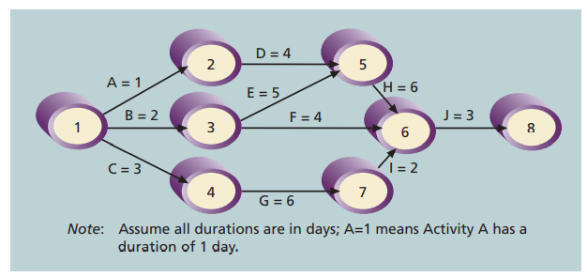
AOA-Activity on Arrow

Slide 31
PERT
Program Evaluation and Review Technique
When there is a high degree of uncertainty about the individual activity can be used to estimate project duration.

Slide 32
PERT
PERT uses duration estimates based on using optimistic, most likely, and pessimistic estimates of activity durations—instead of one specific or discrete duration estimate, as CPM does.
To use PERT, you calculate a weighted average for the duration estimate of each project activity using the following formula

Slide 33
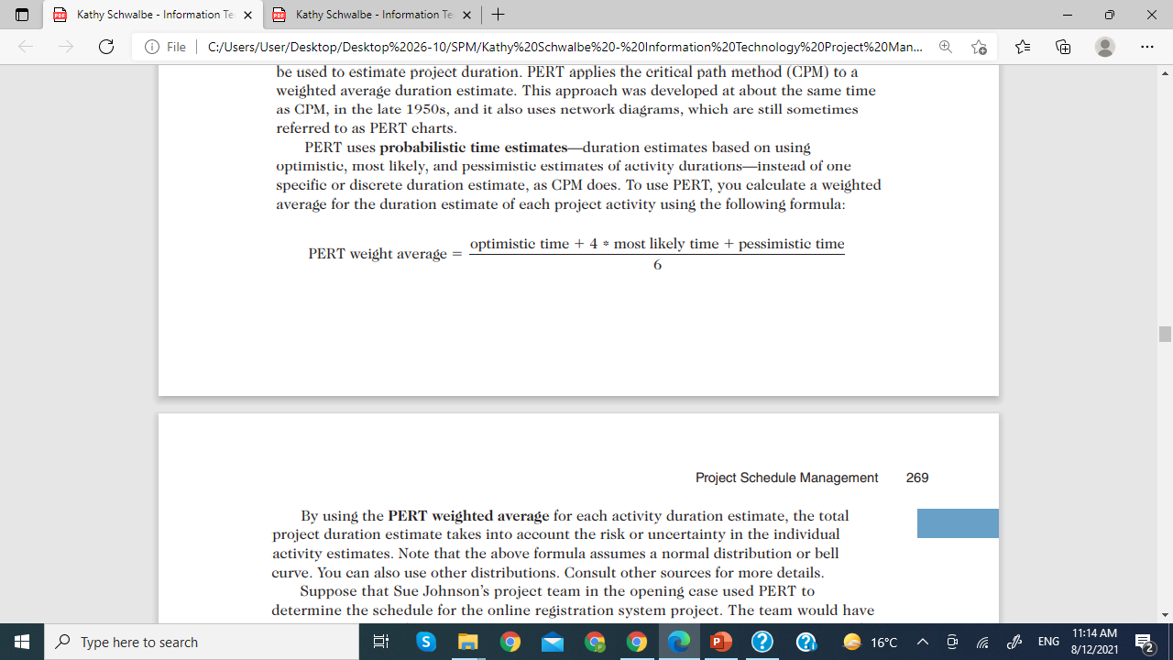
PERT

Slide 34
PERT
By using the PERT weighted average for each activity duration estimate, the total project duration estimate takes into account the risk or uncertainty in the individual activity estimates

Slide 35
Controlling the Schedule
The goal of schedule control is to know the status of the schedule, factors that cause schedule changes, determine that the schedule has changed, and manage changes when they occur

